Slide 1
Enterprise Content Management
Introduction

Slide 2
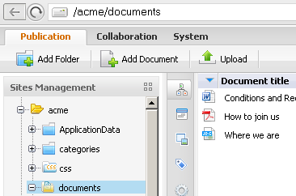
eXo ECM
Open Source alternative for Enterprise Content Management
  Document Management
  Record Management
  Web Content Management
  Collaboration
  Workflow for validation and publishing
  Powerful Search Engine based on
  Apache Lucene
  Microsoft and Open Office plugins to facilitate
  inline document editing

Slide 3
eXo ECM
Open Standard based solution
  Content is stored and accessed using the Java Content Repository (JSR-170)
  Extensible Storage: RDBMS, File System, Amazon S3 and SimpleDB
  Standard Remote Protocols: WebDAV, FTP, HTTP, REST,SOAP, CIFS, CMIS

Slide 4
JCR

Slide 5
JCR
  All content in eXo‘s DMS is stored in the JCR.
  JCR stands for Java Content Repository.
  This storage system is defined in a standard called JSR-170.
  The JCR can use different storage systems: RDBMS, File System, Amazon S3 and SimpleDB
  But normally relational database (RDBMS) is used.
  The choice of RDBMS is vast: PostgreS, MySQL, Oracle, Microsoft SQL, IBM DB2 etc.

Slide 6
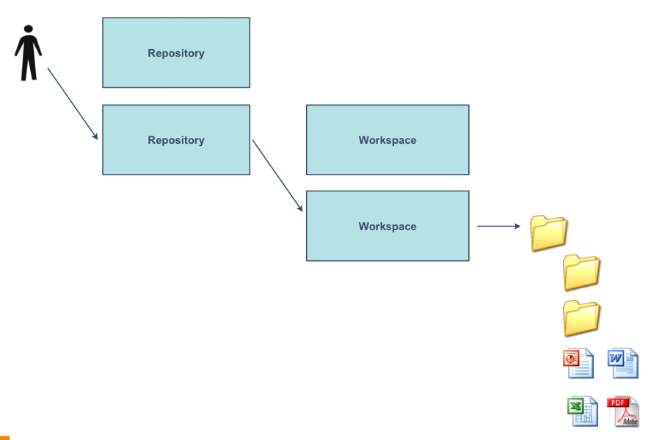
JCR - Structure
  A JCR consists of one or several repositories.
  Each repository can have one or several workspaces.
  Each workspace has its own root folder.
  In each folder there can be subfolders and content.

Slide 7
JCR - Nodes
  Technically we do not speak of folders and content but of “nodes”.
  That way a JCR is an hierarchical structure of nodes – a node tree.
    Each node has a parent node.
    Each node can have child nodes (or subnodes).
    Nodes can be of different types, these types are called “node types”.
  A node consists of properties and of child nodes.
  A node can be a folder or any document or file like for example: a pdf document, a word document, an article, a web content, an image, a video, an audio file, etc.

Slide 8
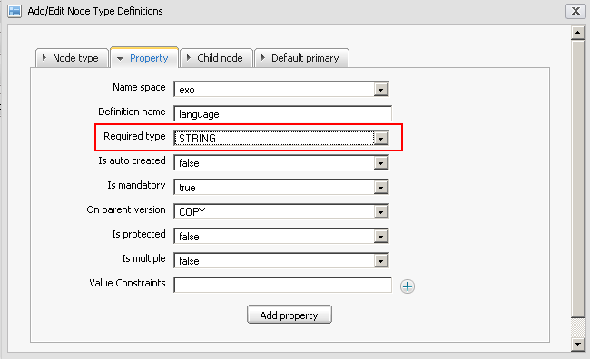
JCR – Properties
  A property of a node contains a chunk of information.
  Each property has got a type: text, number, date or binary.

Slide 9
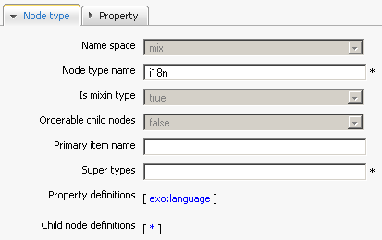
JCR – Node Types
  A node type defines the properties and the possible child nodes of a nodes.
  A node type must be either“primary”or“mixin”:
    Primary node type: Each node is defined by exactly one primary node type.
    Mixin node type: Each node can integrate properties of 0 or several mixin node types. (For java experts: Mixins are often compared to java interfaces.)

Slide 10
Sites Explorer

Slide 11
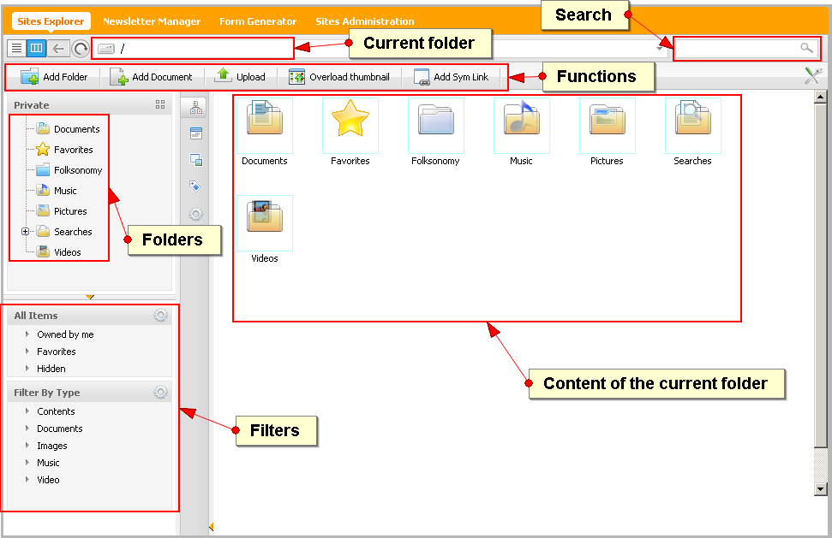
Sites Explorer

Slide 12
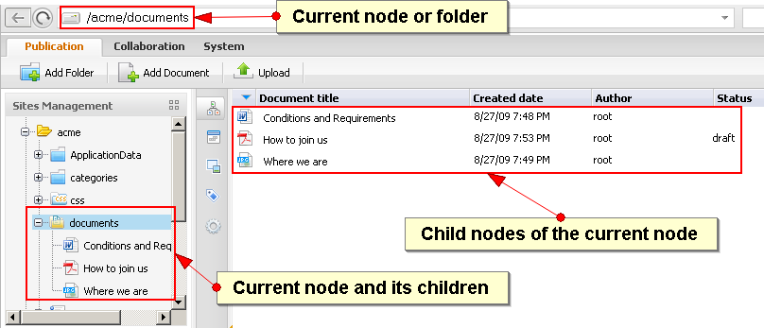
Sites Explorer
Current node
  You always have a current node.
  The right panel shows the content of the current node or its child nodes.

Slide 13
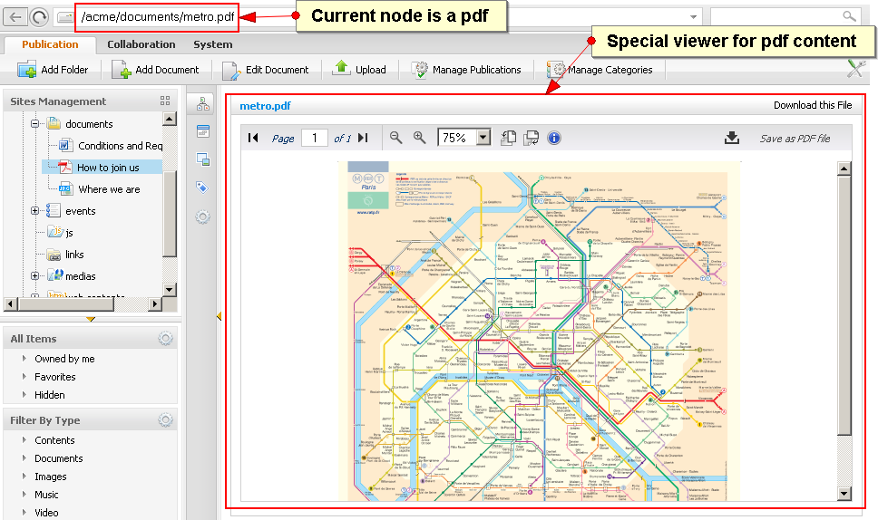
Sites Explorer
  If the current node is not a folder, a viewer shows the content
  There is a viewer template for each nodetype.

Slide 14
Site Explorer Functions

Slide 15

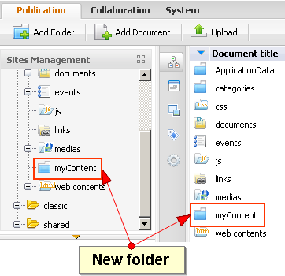
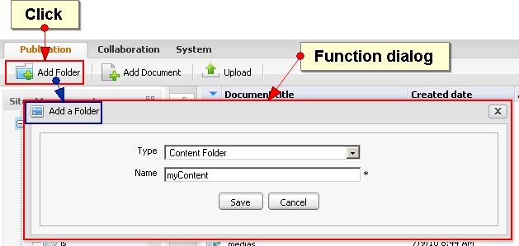
Sites Explorer: Functions
  A function can give information or alter the content or structure of the repository.

Slide 16
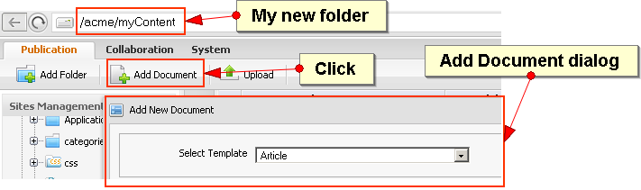
Sites Explorer: Functions
  Each function has its own dialog.

Slide 17
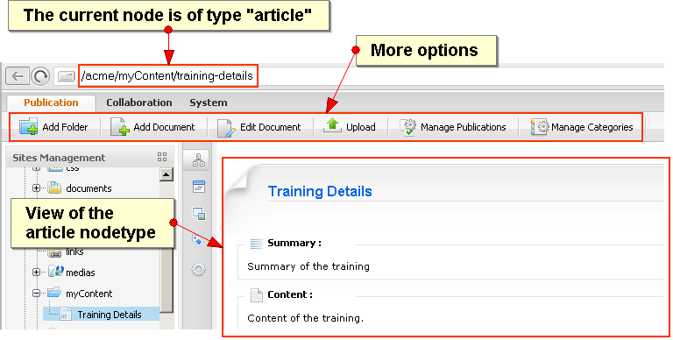
Sites Explorer: Functions
  The choice of functions changes depending on the nodetype of the current node.

Slide 18
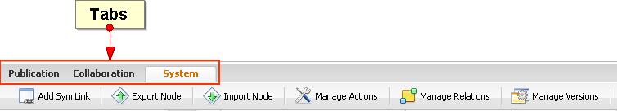
Sites Explorer: Functions
  If there are many functions they are organized in several tabs. Each tab gives access to different functions.

Slide 19
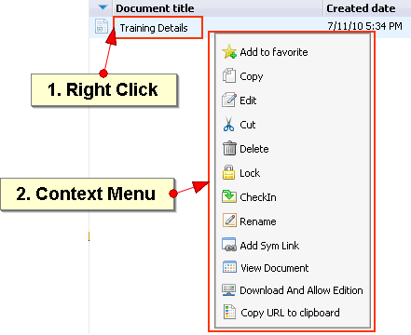
Sites Explorer: Functions
  There are more function in the context menu, accessible by a right click.
  The context menu varies according to node type.

Slide 20
Exercise: Functions
Folder
Open the “acme“ folder.
Create a new folder “myContent“.
Open the “myContent” folder.
Functions
Create an article by clicking on “Add Document“.
Go to your new article and observe how the available functions change.
Click on “Edit Document“ and modify your document.
Create a subfolder and copy your document there.
Rename the copied article.

Slide 21
Symbolic Links

Slide 22
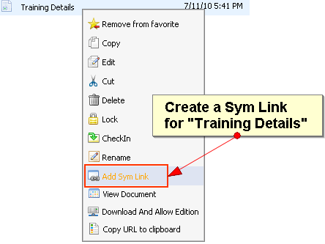

Sites Explorer: Symbolic Link
  SymLinks or symbolic links are links to an other node in the repository.
  A symbolic link is a place holder for the linked node.

Slide 23
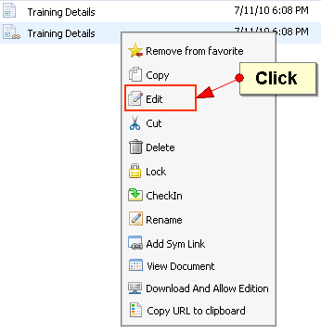
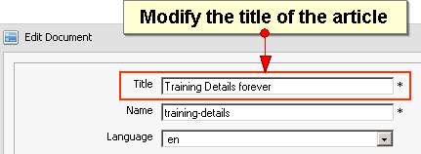
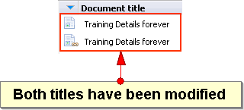
Sites Explorer: Symbolic Link
  The SymLink of an article points actually to the very same article.

Slide 24
Exercise: Symbolic Link
Create a symbolic link of your article.
Right-click on your symlink and modify the content. Save.
Open your original article and look out for your modifications.
Create a subfolder and move (cut and paste) your symlink to the subfolder

Slide 25
Direct Access

Slide 26
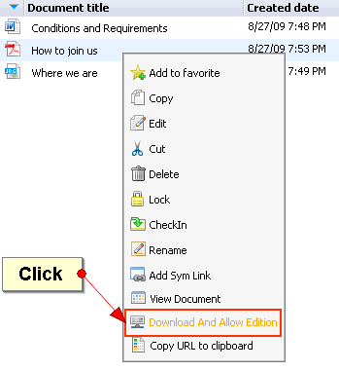
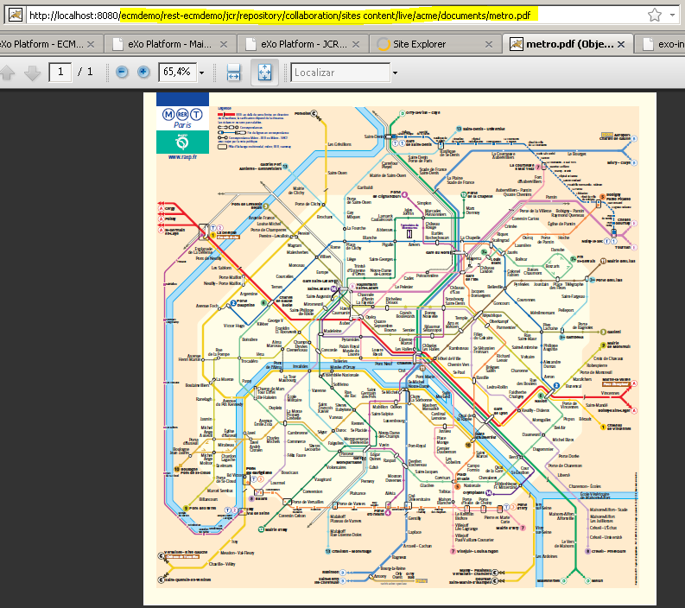
Direct Access – in the browser
Open any node using a direct URL. This is also called “rest exposition”.
Rendering of the document is done by the browser.

Slide 27
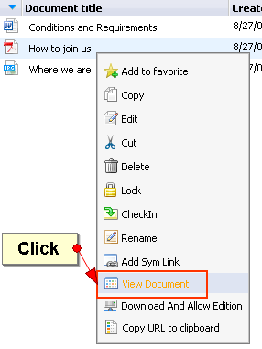
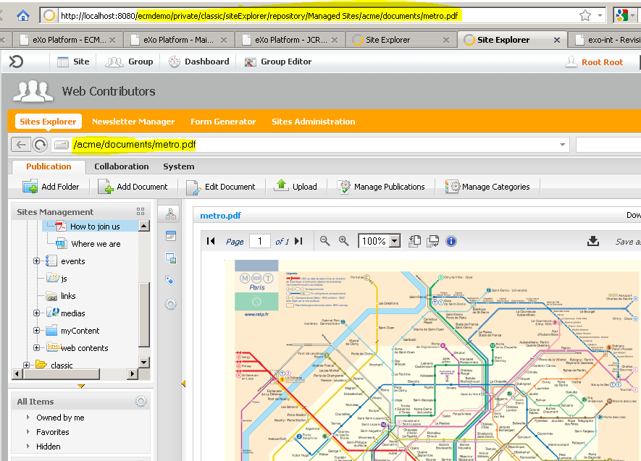
Direct Access – inside the explorer
View a document using a direct URL.
In fact you open the content explorer that accesses the document.

Slide 28
Exercise: WebDav
  Connect to your server by WebDAV (Office, WebFolder)
  http://127.0.0.1:8080/portal/rest/jcr/repository/collaboration/
  With linux nautilus:
  dav: 127.0.0.1:8080/portal/rest/jcr/repository/collaboration/
  With Windows:
  Open File Explorer, Right click and choose “Connect to a network drive”.
  Copy some documents to the folder “/sites content/live/acme/documents”.
  Open the content explorer and verify the presence of the copied documents.

Slide 29
Categories

Slide 30
Sites Explorer: Categories
  Categories allow you to organize your content and documents according to your needs.
  Each content can be in several categories.
  Categories are organized in so called “taxonomy trees”.

Slide 31
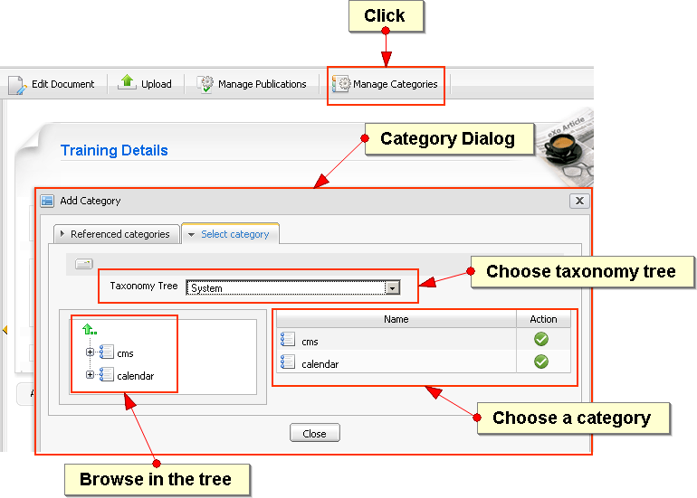
Sites Explorer: Categories

Slide 32
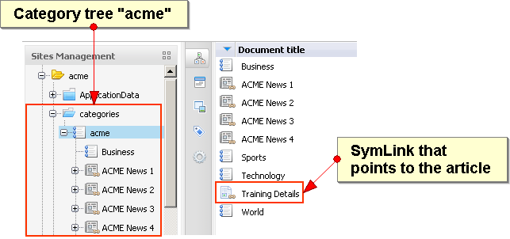

Sites Explorer: Categories
  Technically, whenever you add a content to a category you add a symbolic link to the category tree.

Slide 33
Exercise: Categories
Upload
Login as john. Open your private drive.
Upload a pdf document and an image.
Add your documents to the taxonomy tree“acme”in the category „From the lab”.
Assign some tags in the scope “public”
Vote for the documents.
Assign a category
Create a new article in “Sites Content – acme – web content“.
Assign your article to the category “acme/World” and to “events/All/jobs”.
Open the events category tree and find your article in this category.

Slide 34
Exercise: Categories
New Category
Open the event drive (This is a category drive).
Open the folder “All”. In “All”, create a new category “bike”.
Create a new events document in the bike category.
Your new document is automatically copied to a different folder. Now publish the document.
Go to acme site and open in the navigation “events”. Search for your new document

Slide 35
Views and Drives

Slide 36
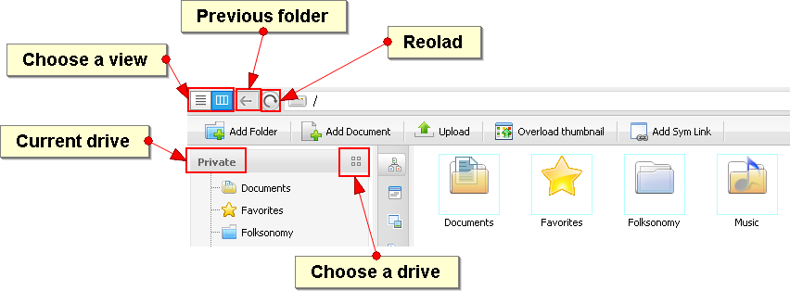
Sites Explorer

Slide 37
Sites Explorer: Views
The view defines:
  A number of available functions.
  The way the current content is rendered. This is defined in a template known as ECM or View Templates.
  A view is related to a given membership or a group. That means some views are only available to a restricted group of users.
  In consequence, users with more groups can access to more views.

Slide 38
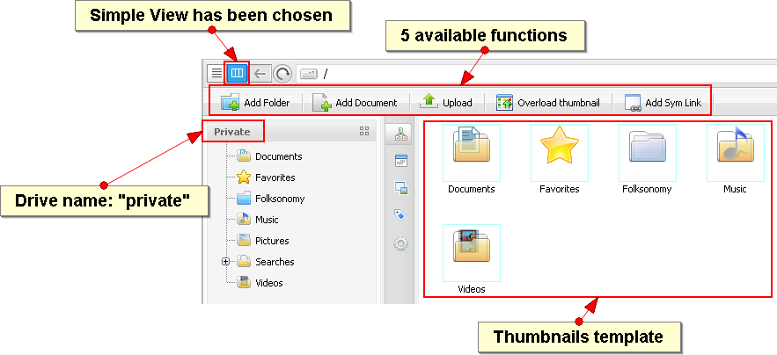
Sites Explorer: Views

Slide 39
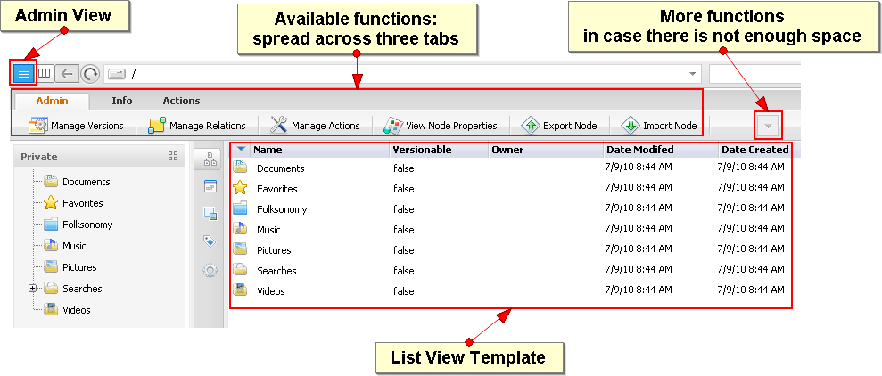
Sites Explorer: Views

Slide 40
Sites Explorer: Drives
A drive gives you access to a part of the content of the underlying workspace.
Personalized Workspace
  Defines a root path
  A set of views
  A set of permissions
Options
  Drive behavior
  User Navigation
  User, Group and General drives
Users have access to several drives, depending on their groups.
You only can use/see one drive at the same time.

Slide 41
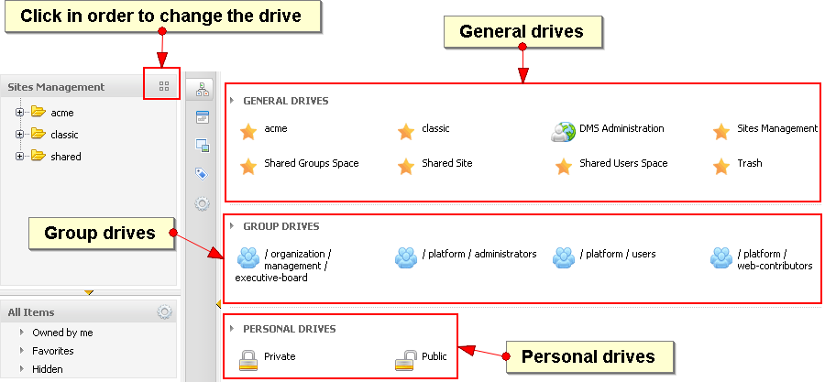
Sites Explorer: Drives
You only see the drive you have access.

Slide 42
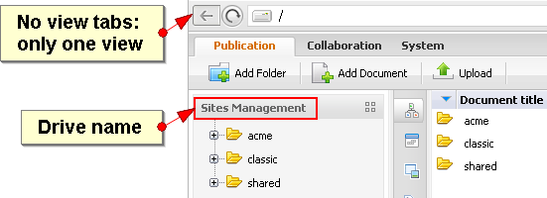
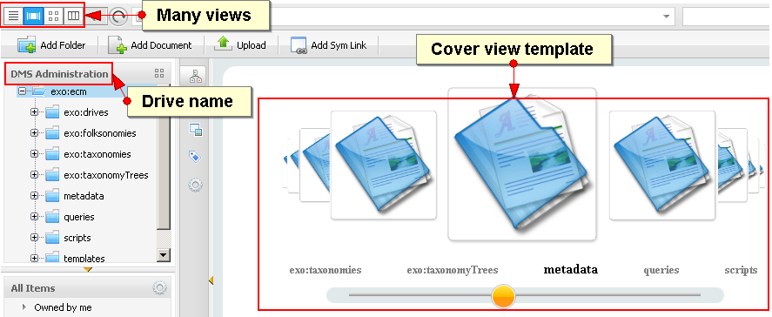
Sites Explorer: Drives

Slide 43
Exercise: Using Views and Drives
Views and Drives
Log in as root.
Open the DMS Administration drive. Do not alter the content.
Test the views of this drive. Note that there is an admin view (“Details”) with three tabs and a lot of functions. Test the tabs.
Note the different “View templates” that render the current content in different ways.
Permissions:
Log in as“mary”.
Does mary see the“DMS Administration drive?
Open the public drive of mary. Does mary see the“admin view”

Slide 44
Drives (Backoffice)

Slide 45
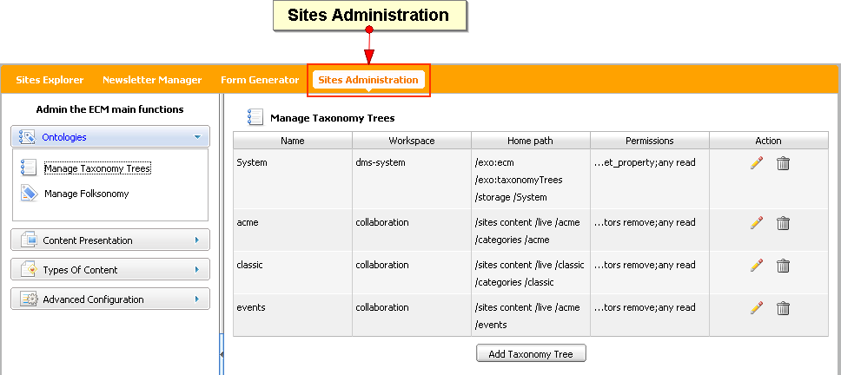
Drives

Slide 46
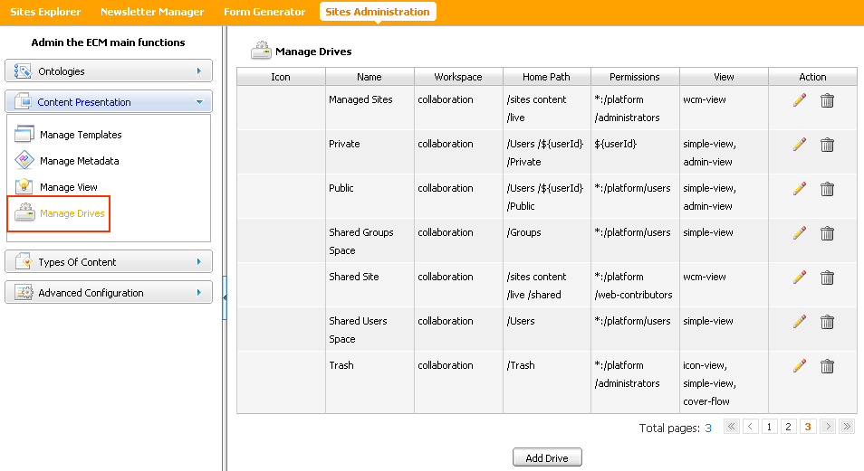
Drives

Slide 47
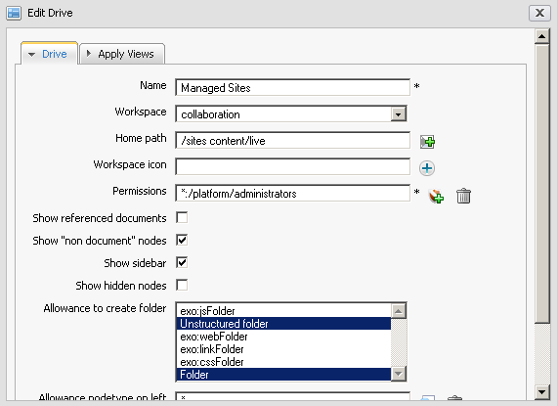
Drives

Slide 48
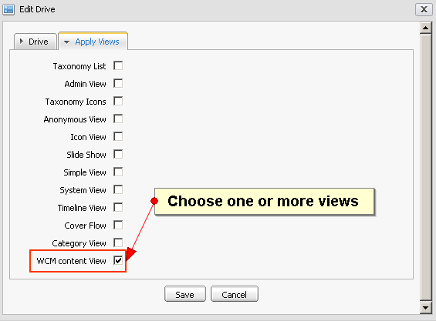
Drives

Slide 49
Views (Backoffice)

Slide 50
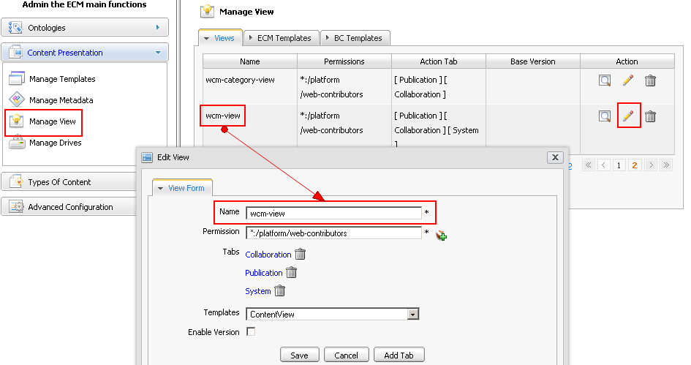
View

Slide 51
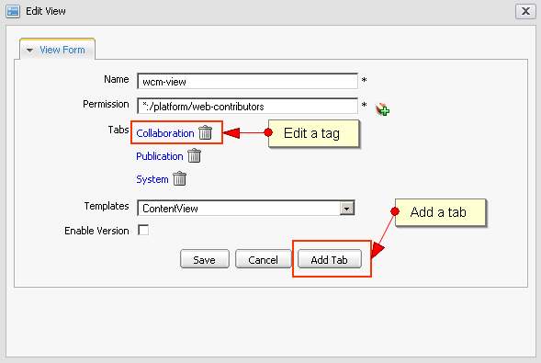
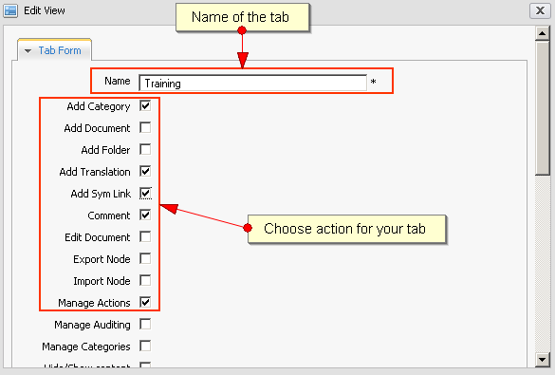
View
The function list is
extendable by developers.

Slide 52
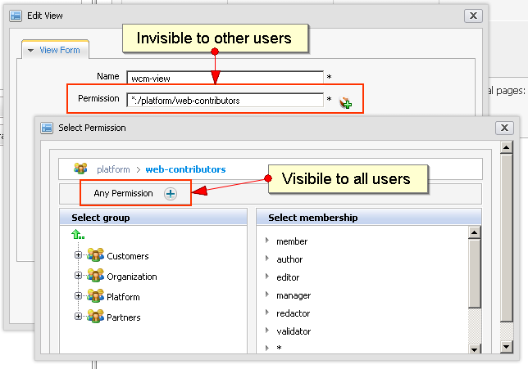
View

Slide 53
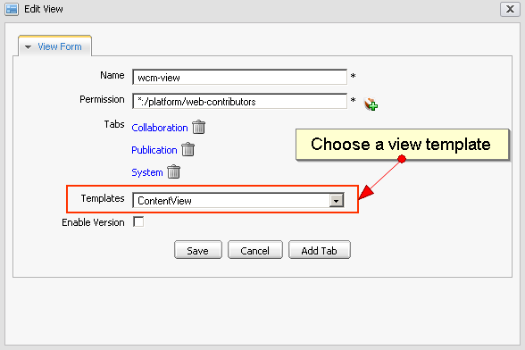
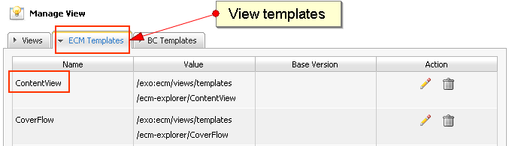
View

Slide 54
Exercise: Creating Views and Drives
View
Create a new view “PowerView” using the template ListView.
Assign 2 tabs to your view.
Assign to “PowerView” 10 functions, spread the functions across the 2 tabs.
Drive
Assign your view to a new drive “RootDrive”
In this new drive you can see everything of the collaboration workspace, only users of the role “member:/platform/users” can use this drive.
Check the box for the left sidebar.
Choose “Unstructured Folder” (Content Folder)
Open the drive in the site explorer.

Slide 55
Exercise: Creating Views and Drives
Simple Interface
Your boss asks you to make a very simple site explorer interface for people whose computer knowledge is quite low.
Create a view only for adding and editing documents (2 functions).
Create a subfolder “webdocs” in Acme.
Create a drive pointing to “webdocs”.
Open this drive with the file explorer.

Slide 56
Exercise: Customized Explorer
Login as root. Open the Acme site.
Add a page with a site explorer (content explorer).
Open the explorer in Edit mode.
Test the different options, each time go back to view mode and test it.
Jailed Explorer
Choose “jailed” and then the drive “Managed Sites”.
Parameterized Explorer
Choose “Parameterize”, “Managed Sites”, and the “acme/documents”.
Personal Explorer
Choose “Personal” and test with different users.
Selected Explorer
Choose “Selection” and the drive “classic”.

Slide 57
Taxonomy

Slide 58
Taxonomy Tree
A taxonomy tree is a folder (and its subfolders) in the DMS.
Each folder can contains subfolders which are subcategories.
The folders do not contain the documents itself, but symbolic links which point to the actual document.
Each taxonomy tree contain an action (TaxonomyAction) which on creation of a document moves the document to a destination folder and creates a symlink which points to the document.

Slide 59
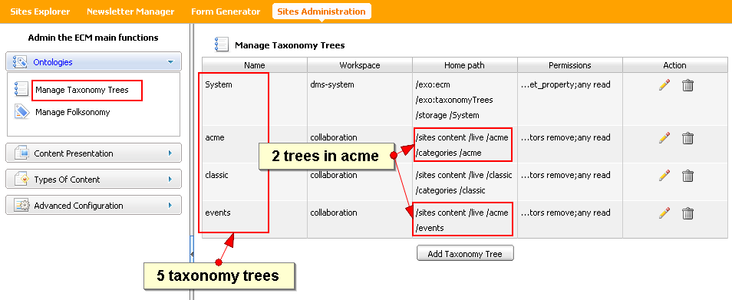
Taxonomy Tree

Slide 60
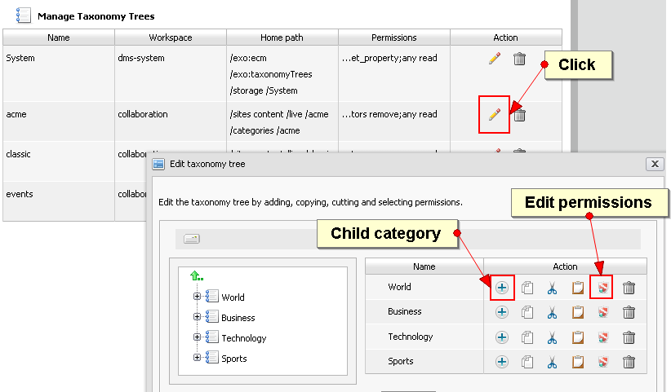
Taxonomy Tree

Slide 61
Taxonomy Tree
Permission
You can exclude some users from choosing certain categories
You control this by giving permissions to the concerned categories.

Slide 62
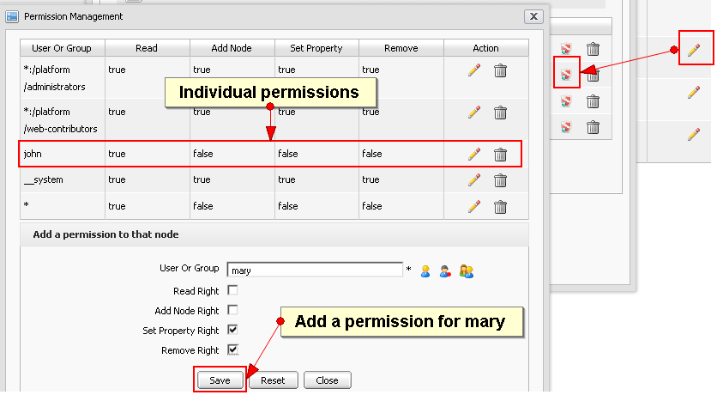
Taxonomy Tree

Slide 63
Exercise: Taxonomy Tree
  Log in as john.
  Create a new taxonomy tree called “Bike”. Place it in “shared”.
  Enter the categories “sports”, “urban”, “folding”.
  Use the workspace “collaboration” for the taxonomy tree.
  For the lifecycle use “node added”.
  For the target, use also the workspace “collaboration” but a different place.
  Open the new taxonomy tree. Create a new document inside a category. Observe how the action moves the document to the target folder and creates a symlink inside the category folder.
  Extra for experts: Create a drive pointing to your new category tree (Like the events drive). Then create a page that shows the new category tree (like events).

Slide 64
Permissions

Slide 65
Permissions
  Each node can have permissions on it.
  If there are no permissions for a node: the permissions of the parent node are applied.
  If the parent node neither has permissions the grand-parent’s permissions are applied, etc. etc.
  The content explorer shows those permissions that are valid for the current node - it does not indicated whether the permissions are actually inherited. When you start modifying the permissions and the permissions are inherited, the content explorer copies first the inherited permissions to the current node and applies then the modifications.
3

Slide 66
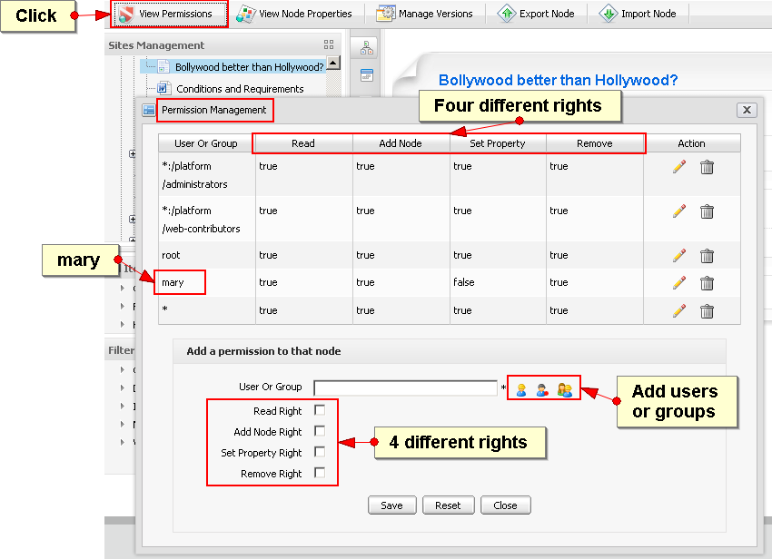
Permissions
3

Slide 67
Exercise: Permissions
Change the permissions of a node, the user mary should be able to modify it.
3

Slide 68
Node Types

Slide 69
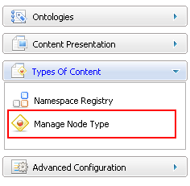
Node Type
Namespace, NodeType and Templates
There are many different nodetypes for a JCR.
A nodetype defines the properties and possible child nodes.
A nodetype can inherit from other nodetypes.
The nodetype then inherits property and child node definitions.

Slide 70
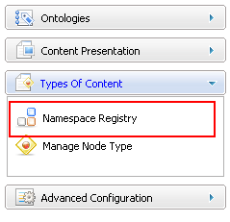
Namespace
Namespace
Each nodetype and property belongs to a namespace.
The namespace helps to avoid name conflicts. (When different organizations uses the same name.)
A namespace is a prefix,
defined a URL. (Similar to xml.)
The namespaces are managed
in a namespace registry.
Do not hesitate to create your
own namespace(s) for your
nodetypes and properties.

Slide 71
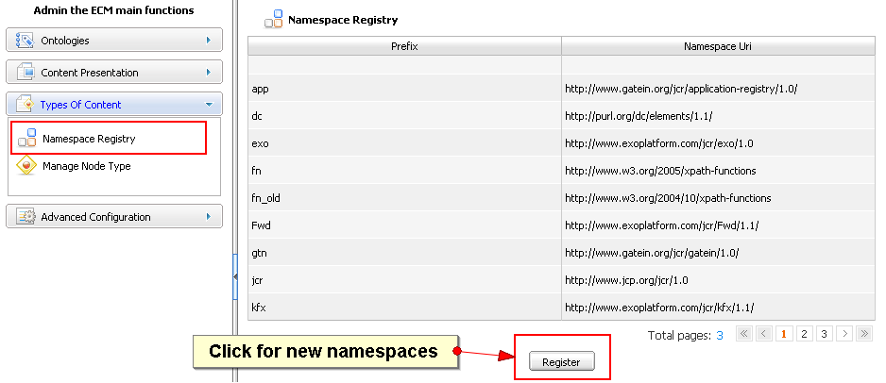
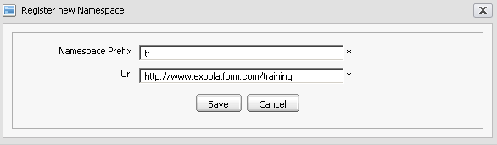
Namespace

Slide 72
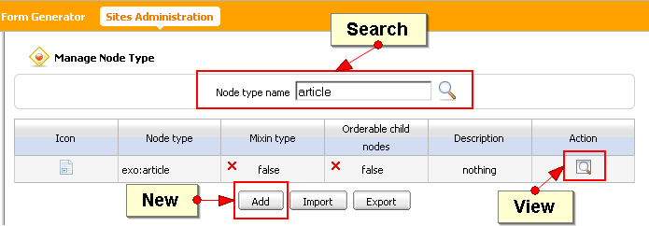
Node Type

Slide 73
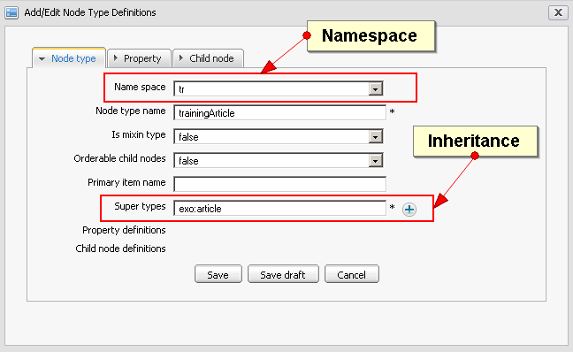
Node Type

Slide 74
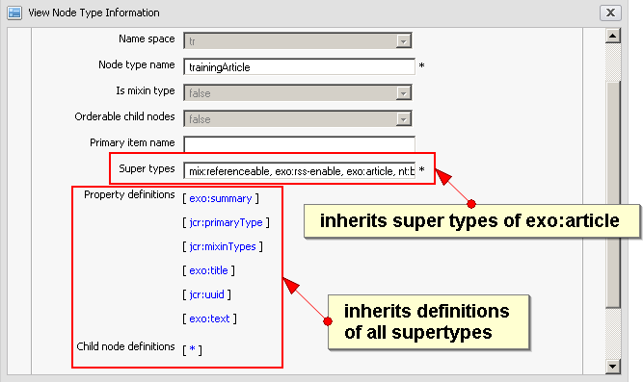
Node Type

Slide 75
Document Types

Slide 76

Document Type
Document types are node types for which you created a dialog and a view template.
Document type dialog templates appear in the “Add Document” dialog of the site explorer.

Slide 77

Document Type
The view of a document type is used for showing the content.

Slide 78

Document Type
You can modify current templates or create new ones.

Slide 79

Document Type
You can modify current templates or create new ones.

Slide 80

Document Type
The dialog and view templates are written in groovy template language.

Slide 81

Document Type
The dialog is now in the template list.

Slide 82
Exercise: Document Type
  Document Type
  Create a namespace “tr”
  Create a node type “bikeArticle” that inherits from “exo:article”. Do not save yet! Add the text property “model“ and the number property “price“ to the bike article. Now, save the node type.
  Open the manage templates interface, Click on “Add”. Choose the node type “bikeArticle” and create a view and a dialog (they will be generated automatically).
  Open the site explorer, drive “Sites Management” – path “web contents” – and test your new document type.

Slide 83
Forms

Slide 84
Exercise: Fast Content Creator
  Form Generator
  Your finance director wants to cut costs. Therefore Internet users shall make order for the bikes by an new form.
  Use the “Form Generator” to create a new dialog for bike orders. Fields: Name, email address, telephone, select box with three bike models, remarks.
  Test the new dialog in the site explorer.
  Find the node types, dialogs and forms of the “bike orders”.
  Fast Content Creator
  Open the application registry and import all applications.
  For your new site, create a new page and drag the “Fast Content Creator” to the page. Modify the settings of this application using the new “bike orders” dialog.
  Create new bike orders using the form.

Slide 85
Actions

Slide 86
Triggers – Actions
  You can link an action to any node.
  Action Types:
  Business Process: Workflow integration with Bonita or JBPM,
  Groovy Script: A java implementation.
  The action can be triggered when
  A node is added, deleted or read,
  A property is added, deleted or read,
  or the scheduler triggers the action.
  Actions are node types
  You can find them in the node type list.

Slide 87

Actions

Slide 88


Scheduled Actions
  Schedule Types:
  Cron: A cron expression can define any period, repetitions, weekdays etc. – a little bit cryptic.
  Period: Start and End time, number of repetitions and a time interval.

Slide 89

Actions

Slide 90
Enterprise Content Management
Introduction

